Slide 1
Register and Counters
Digital Logic & Design
LAB 12

Slide 2
Register
A Register is a group of flip‐flops
Shares a Common Clock and is
n bit register consists of a group of n flip‐flops capable of storing n bits of binary information.

Slide 3
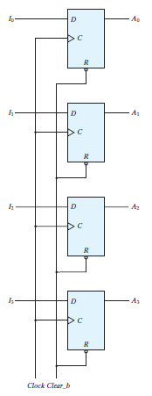
4-Bit Register

Slide 4
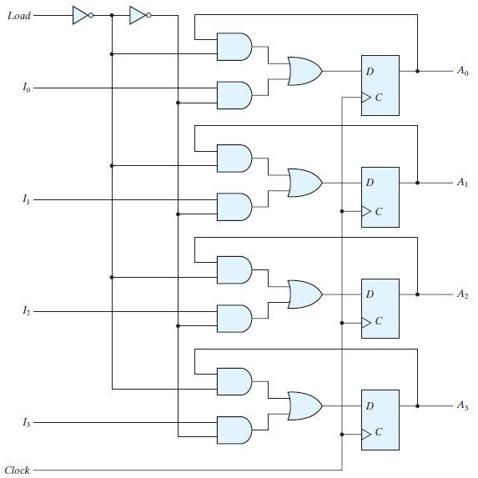
4-Bit Register with Parallel Load

Slide 5
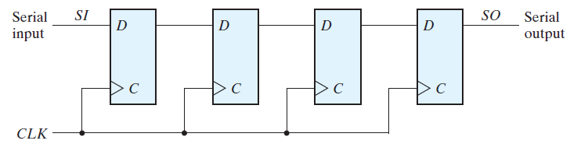
SHIFT REGISTERS

Slide 6
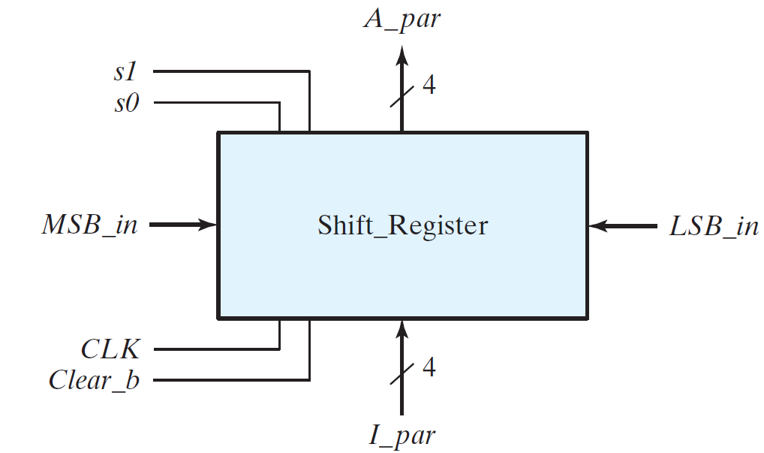
UNIVERSAL SHIFT REGISTER

Slide 7
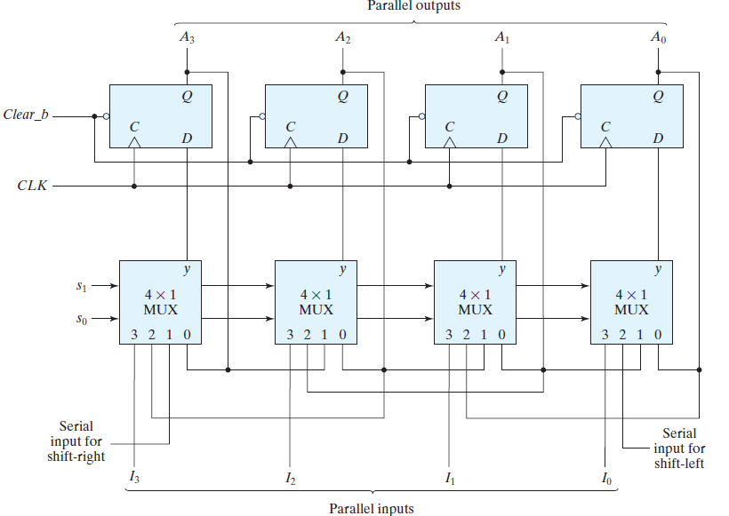
UNIVERSAL SHIFT REGISTER

Slide 8
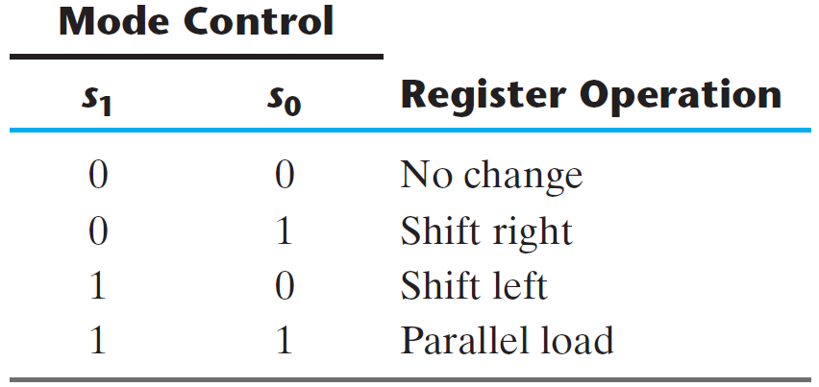
UNIVERSAL SHIFT REGISTER

Slide 9
UNIVERSAL SHIFT REGISTER
74xx194 (4-BIT BIDIRECTIONAL UNIVERSAL SHIFT REGISTER)

Slide 10
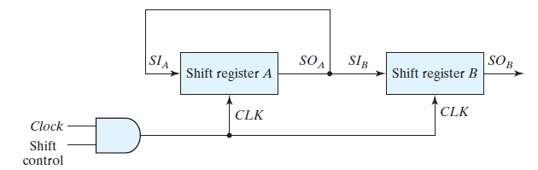
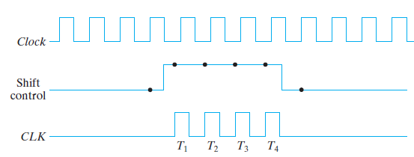
SERIAL TRANSFER

Slide 11
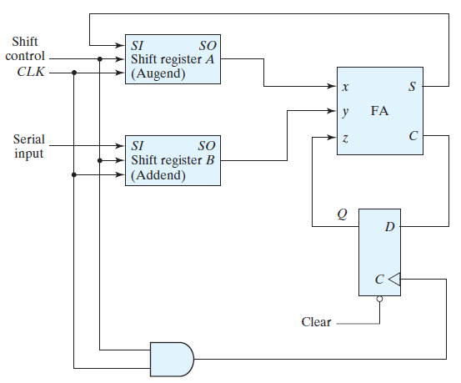
SERIAL ADDER

Slide 12
COUNTER (Asynchronous)
74xx93 is a Asynchronous Binary Counter
Single Flip Flop
3 Bit Asynchronous counter

Slide 13
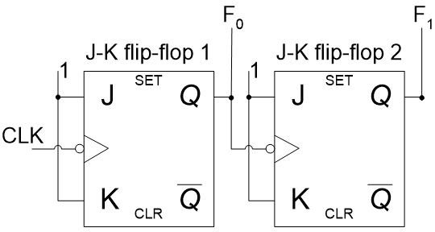
2-bit Asynchronous Up-Counter

Slide 14
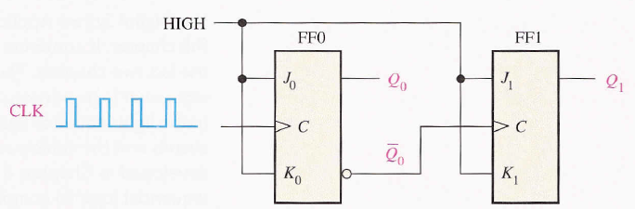
2-bit Asynchronous Up-Counter

Slide 15
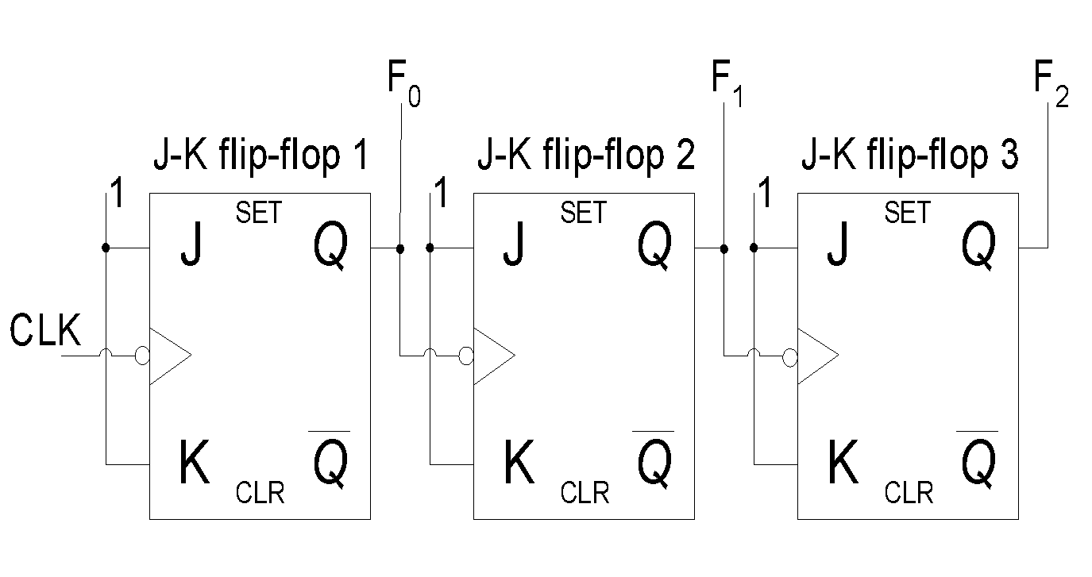
2-bit Asynchronous Up-Counter

Slide 16
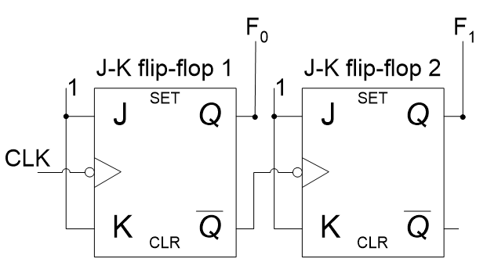
2-bit Asynchronous Down-Counter

Slide 17

3-bit Asynchronous Down-Counter

Slide 18
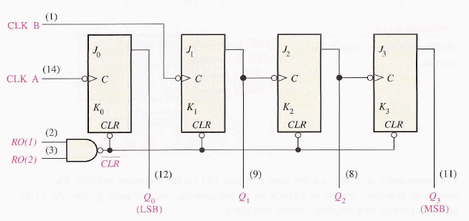
74XX93(4- Bit Asynchronous Binary Counter)

Slide 19
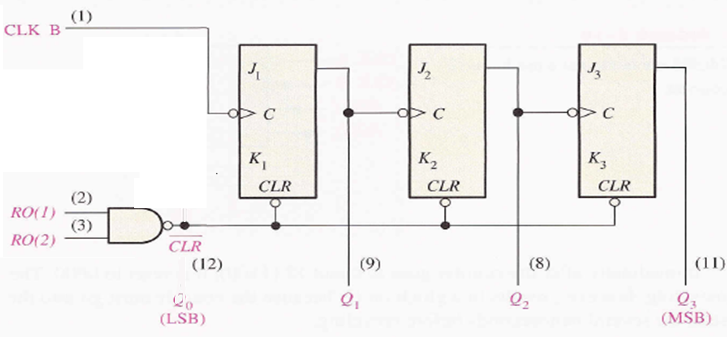
74XX93(3- Bit Asynchronous Binary Counter)

Slide 20
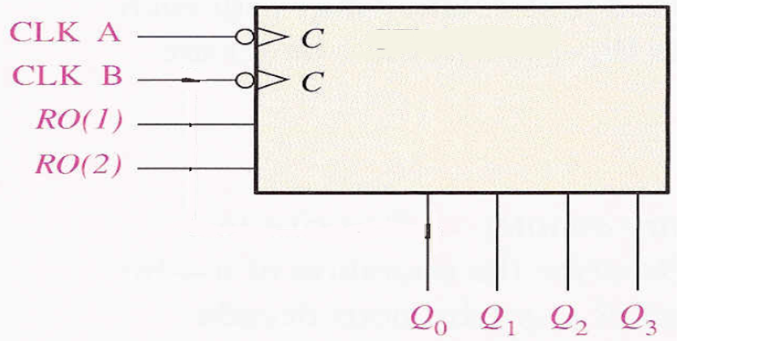
74XX93 BLOCK DIAGRAM

Slide 21
Output State of a 3-bit Asynchronous Up-Counter
Input | Output
Clock Pulses | F₂ | F₁ | F₀
1 | 0 | 0 | 0
2 | 0 | 0 | 1
3 | 0 | 1 | 0
4 | 0 | 1 | 1
5 | 1 | 0 | 0
6 | 1 | 0 | 1
7 | 1 | 1 | 0
8 | 1 | 1 | 1

Slide 22
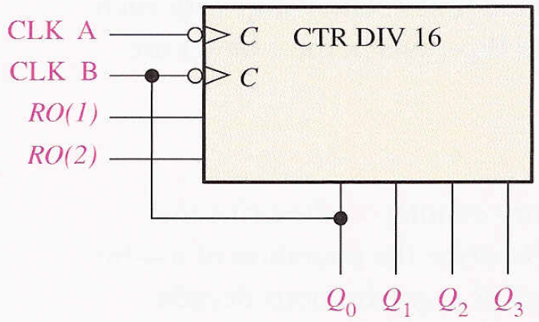
74XX93 As MODULUS 16 COUNTER

Slide 23
74XX93(4- Bit Asynchronous Binary Counter)

Slide 24
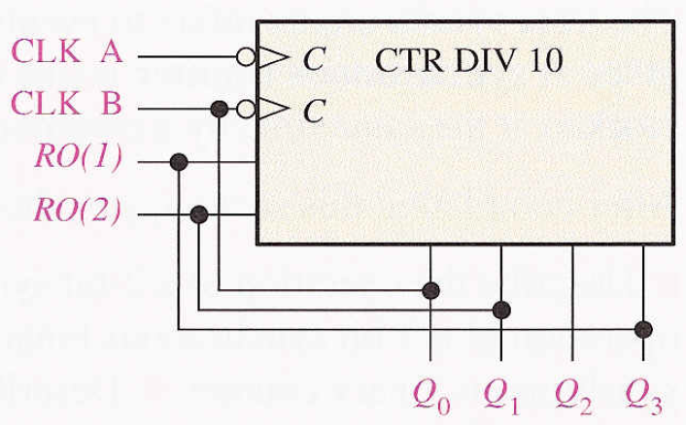
74XX93 As DECADE COUNTER

Slide 25
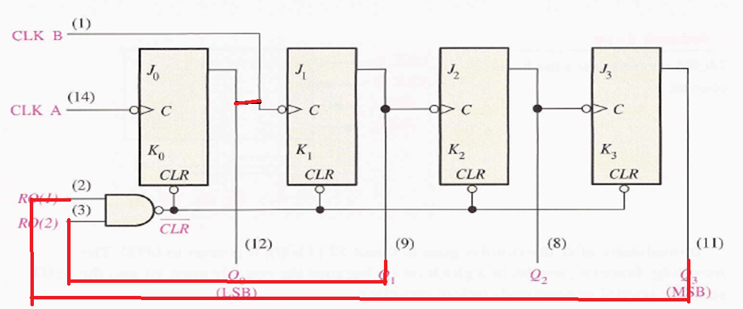
74XX93 As DECADE COUNTER

Slide 26
74XX93(As DECADE COUNTER)

Slide 27
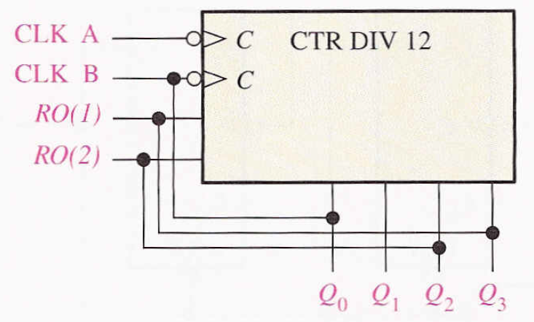
74XX93 As MODULUS 12 COUNTER

Slide 28
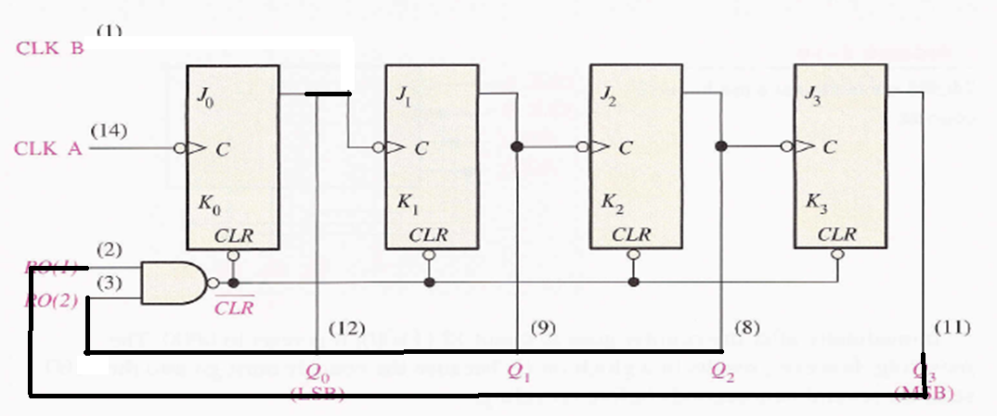
74XX93(As MOD 12 COUNTER)

